Slide 1
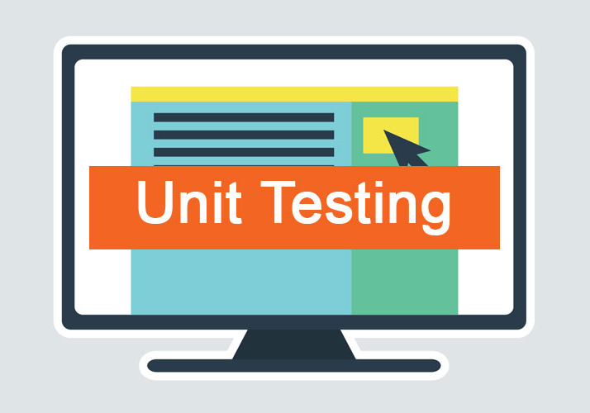
Unit Testing: Arrays and Lists
SoftUni Team
Technical Trainers
Software University
https://softuni.bg

Slide 2
Table of Contents
͏Arrays and Array Operations
͏Lists and List Operations
2

Slide 3
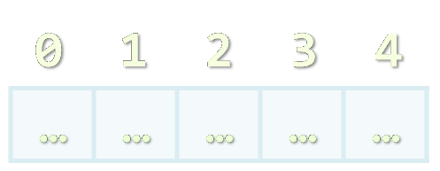
Arrays in C#
Working with Arrays of Elements

Slide 4
What are Arrays?
An array is a sequence of elements
Arrays have fixed size (array.length) and cannot be resized
Elements are of the same type (e. g. integers)
Elements are numbered from 0 to length - 1
0
1
2
3
4
Element’s index
Array of 5 elements
…
…
…
…
…
Element of an array
4

Slide 5
Working with Arrays
Creating an array of 10 integers:
Accessing array elements by index:
Assigning values to the array elements:
int[] numbers = new int[10];
All elements are initially 0
The [] operator accesses elements by index
numbers[5] = numbers[2] + numbers[7];
The Length holds the number of array elements
for (int i = 0; i < numbers.Length; i++)
numbers[i] = 1;
5

Slide 6
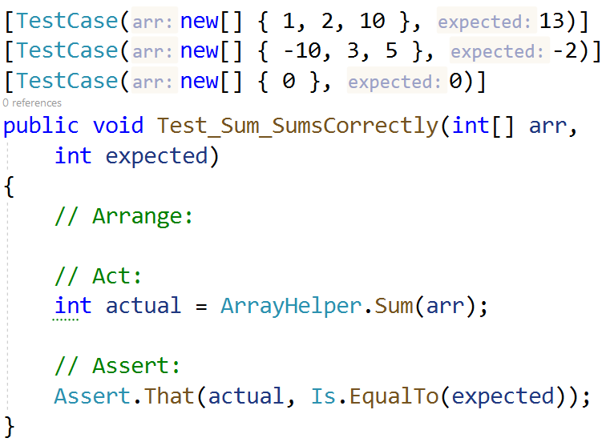
Array Sum – Example
We have a method which takes each element in an array and returns the total sum
public static int Sum(
int[] numbers)
{
int sum = 0;
foreach (int num in numbers)
sum += num;
return sum;
}
6

Slide 7

Lists in C#
Working with Lists of Elements

Slide 8
List<T> – Overview
List<T> holds a list of elements of certain type
Like arrays, but can add / insert / delete elements
List<string> names = new();
names.Add("Peter");
names.Add("Maria");
names.Add("George");
names.Remove("Maria");
Console.WriteLine(string.Join(", ", names));
// Peter, George

Slide 9
List<T> – Overview (2)
List<int> nums = new() { 10, 20, 30, 40, 50, 60 };
nums.RemoveAt(2);
nums.Remove(40);
nums.Add(100);
nums.Insert(0, 5);
for (int i = 0; i < nums.Count; i++)
Console.Write($"{nums[i]} ");
Remove by index
Remove by value (slow)
Inserts an element at index 0
Numbers of items in list
5 10 20 50 60 100

Slide 10

Summary
Arrays hold a sequence of elements
Elements are numbered from 0 to length – 1
Lists are like arrays, but can add / remove / insert / replace / find elements
Notes:
10

Slide 11
Questions?
Notes:
11

Slide 12













SoftUni Diamond Partners

Slide 13
Trainings @ Software University (SoftUni)
Software University – High-Quality Education, Profession and Job for Software Developers
softuni.bg, about.softuni.bg
Software University Foundation
softuni.foundation
Software University @ Facebook
facebook.com/SoftwareUniversity
Software University Forums
forum.softuni.bg
13
Notes:
13

Slide 14

License
This course (slides, examples, demos, exercises, homework, documents, videos and other assets) is copyrighted content
Unauthorized copy, reproduction or use is illegal
© SoftUni – https://about.softuni.bg
© Software University – https://softuni.bg
Notes:
14

